Slide 1
CDB3033N :
Database
Programming
Prepared by Jay Ch’ng

Slide 2
CDB3033N
Database Programming
SELECT Statement With Condition – IN Operator
The IN operator allows you to specify multiple values in a WHERE clause, and basically it is a shorthand for multiple OR conditions.
Example
SQL:
SELECT * FROM `customers` WHERE first_name IN('Tan', 'Ang', 'Xin')

Slide 3
CDB3033N
Database Programming
SELECT Statement With Condition – LIMIT Clause
The LIMIT clause is used to specify the number of records to return. It is useful on large tables with thousands of records. Returning a large number of records can impact performance.
Example 1
Example 2: Offset
Example 3: Offset
Only return the first two records:
The first row data will start at zero not one:
The SQL query below says "return only 3 records, start on record 4 (OFFSET 3)":
SQL:
SQL:
SELECT * FROM `customers` LIMIT 2
SELECT * FROM `customers` ORDER BY first_name ASC LIMIT 0, 3
SQL:
SELECT * FROM `customers` ORDER BY first_name ASC LIMIT 3, 3

Slide 4
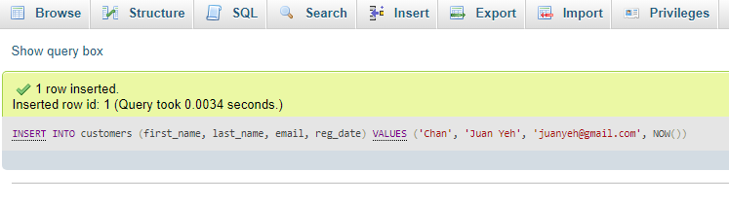
CDB3033N
Database Programming
INSERT INTO Statement
It is used to insert new records in a table.
SQL:
INSERT INTO customers (first_name, last_name, email, reg_date)
VALUES ('Chan', 'Juan Yeh', 'juanyeh@gmail.com', NOW());

Slide 5
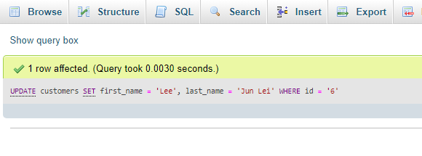
CDB3033N
Database Programming
UPDATE Statement
It is used to modify the existing records in a table.
SQL:
UPDATE customers
SET first_name = 'Lee', last_name = 'Jun Lei'
WHERE id = '6';

Slide 6
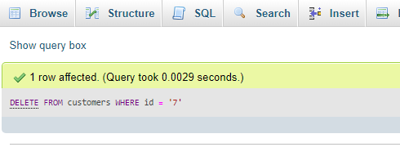
CDB3033N
Database Programming
DELETE Statement
It is used to delete existing records in a table.
SQL:
DELETE FROM customers WHERE id = '7';

Slide 7
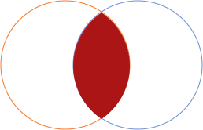
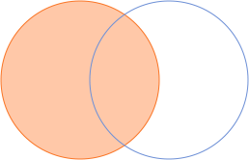
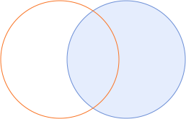
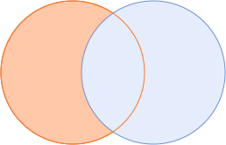
Table: User
Table: Hobby
JOIN Statement
ID | User
1 | Jay
2 | Jane
3 | Jenny
4 | Johnson
5 | Eric
6 | Peter
User ID | User
3 | Hiking
5 | Basketball
3 | Running
1 | Cycling
2 | Football
7 | Fishing
The JOIN clause is used to combine rows from two or more tables, based on a related column between them.
INNER JOIN
LEFT JOIN
RIGHT JOIN
OUTER JOIN
Or JOIN
Or JOIN
Or JOIN
Or UNION
User | Hobby
Jay | Cycling
Jane | Football
Jenny | Hiking
Jenny | Running
Eric | Basketball
User | Hobby
Jay | Cycling
Jane | Football
Jenny | Hiking
Jenny | Running
Johnson | NULL
Eric | Basketball
Peter | NULL
User | Hobby
Jenny | Hiking
Eric | Basketball
Jenny | Running
Jay | Cycling
Jane | Football
NULL | Fishing
User | Hobby
Jay | Cycling
Jane | Football
Jenny | Hiking
Jenny | Running
Johnson | NULL
Eric | Basketball
Peter | NULL
NULL | Fishing

Slide 8
CDB3033N
Database Programming
JOIN Statement
The JOIN clause is used to combine rows from two or more tables, based on a related column between them.
Example 1 – LEFT JOIN
Example 2 – LEFT JOIN WITH WHERE CONDITION
SQL:
SQL:
SELECT c.*, a.* FROM customers c
LEFT JOIN address a ON(c.id = a.cus_id)
SELECT c.*, a.* FROM customers c
LEFT JOIN address a ON(c.id = a.cus_id)
WHERE c.id = '3'

Slide 9
CDB3033N
Database Programming
GROUP BY Statement
The GROUP BY statement groups rows that have the same values into summary rows, like "find the number of address in each customers".
SQL:
SELECT c.first_name, c.last_name, COUNT(*) AS total_address
FROM customers c
LEFT JOIN address a ON(c.id = a.cus_id)
GROUP BY a.cus_id

Slide 10
CDB3033N
Database Programming
HAVING Clause
The HAVING clause was added to SQL because the WHERE keyword cannot be used with aggregate functions.
Correct SQL
Wrong SQL
SQL:
SQL:
SELECT c.first_name, c.last_name, COUNT(*) AS total_address
FROM customers c
LEFT JOIN address a ON(c.id = a.cus_id)
GROUP BY a.cus_id
HAVING total_address >= 2
SELECT c.first_name, c.last_name, COUNT(*) AS total_address
FROM customers c
LEFT JOIN address a ON(c.id = a.cus_id)
WHERE total_address >= 2
GROUP BY a.cus_id

Slide 11
CDB3033N
Database Programming
UNION Statement
The UNION operator is used to combine the result-set of two or more SELECT statements.
SQL:
SELECT * FROM customers
UNION ALL
SELECT * FROM suppliers
ORDER BY first_name ASC

Slide 12
CDB3033N
Database Programming
BETWEEN Statement
The BETWEEN operator selects values within a given range. The values can be numbers, text, or dates.
SQL:
SELECT * FROM `address`
WHERE addr_postcost BETWEEN 14000 AND 14100
ORDER BY addr_postcost ASC

Slide 13
Q & A
Prepared by Jay Ch’ng

Slide 14
Assignment Discussion
Prepared by Jay Ch’ng

